Slide 1


Logic for Showing Products
Aditya kumar

Slide 2
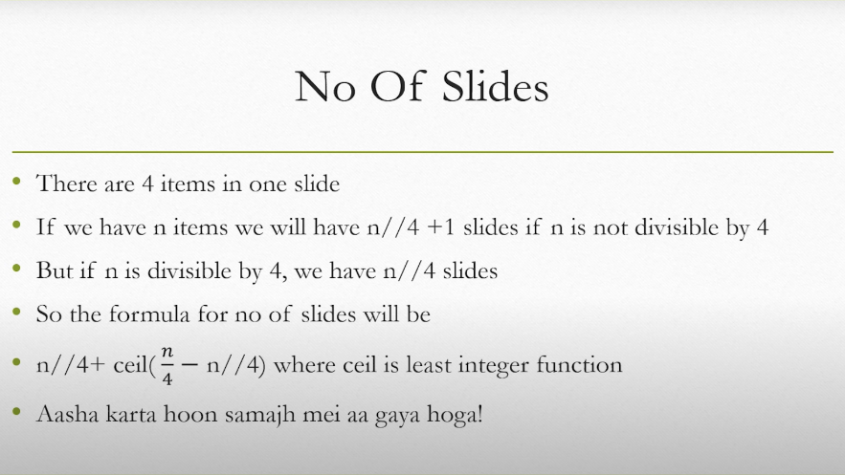

Slide 3
